Slide 1
AI Expert 프로그램 실습
7/9 Graphical Models, Gaussian Process, Hawkes Process

Slide 2
Overview
This tutorial is three-fold as follows:
Graphical Models - 80 min.
Gaussian Process (GP) - 80 min.
Hawkes Process (HP) - 80 min.
* 10 minutes break between each part.

Slide 3
Environments
Python 3.6
virtualenv
Gpy
Matplotlib
Scipy
Image
Tqdm
Ipykernel
Tick Module for statistical learning, with a particular emphasis on time-dependent modelling

Slide 4
Part 0. Environment Setting
Download the source code
cogito@digits-1:~$ git clone https://github.com/cogito288/samsung-ds-kaist.git

Slide 5
Part 0. Environment Setting
Create the virtual environment and activate it
cogito@digits-1:~$ virtualenv -p python3 samdung-ds-0710-env
Already using interpreter /usr/bin/python3
Using base prefix '/usr'
New python executable in /home/cogito/samdung-ds-0710-env/bin/python3
Also creating executable in /home/cogito/samdung-ds-0710-env/bin/python
Installing setuptools, pkg_resources, pip, wheel...done.
cogito@digits-1:~$ source samdung-ds-0710-env/bin/activate
(samdung-ds-0710-env) cogito@digits-1:~$
Install ipykernel package
(samdung-ds-0710-env) cogito@digits-1:~$ pip install ipykernel
(samdung-ds-0710-env) cogito@digits-1:~$ pip install matplotlib
(samdung-ds-0710-env) cogito@digits-1:~$ pip install scipy==1.0.0
(samdung-ds-0710-env) cogito@digits-1:~$ pip install image
(samdung-ds-0710-env) cogito@digits-1:~$ pip install tqdm

Slide 6
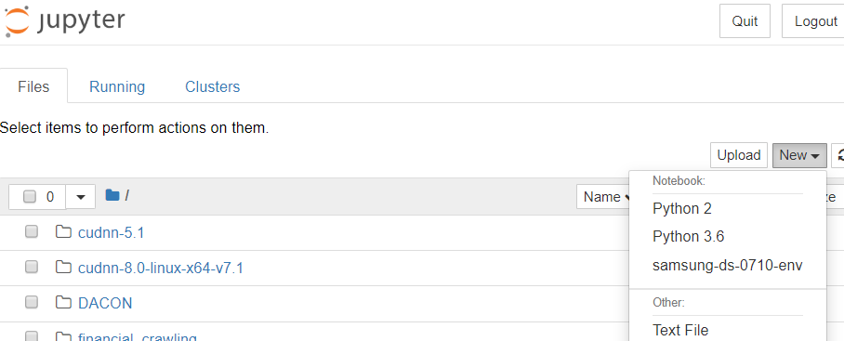
Part 0. Environment Setting
Add virtualenv to Jupyter kernel
cogito@digits-1:~$ python3 -m ipykernel install --user \
--name samsung-ds-0710-env --display-name "samsung-ds-0710-env“
Installed kernelspec samsung-ds-0710-env in /home/cogito/.local/share/jupyter/kernels/samsung-ds-0710-env
cogito@digits-1:~$ jupyter notebook

Slide 7
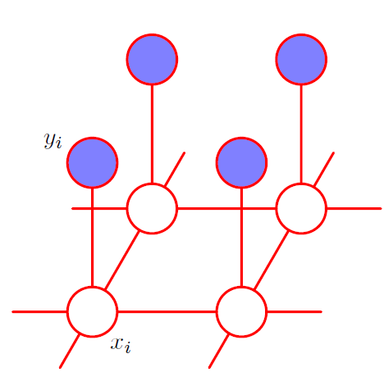
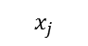

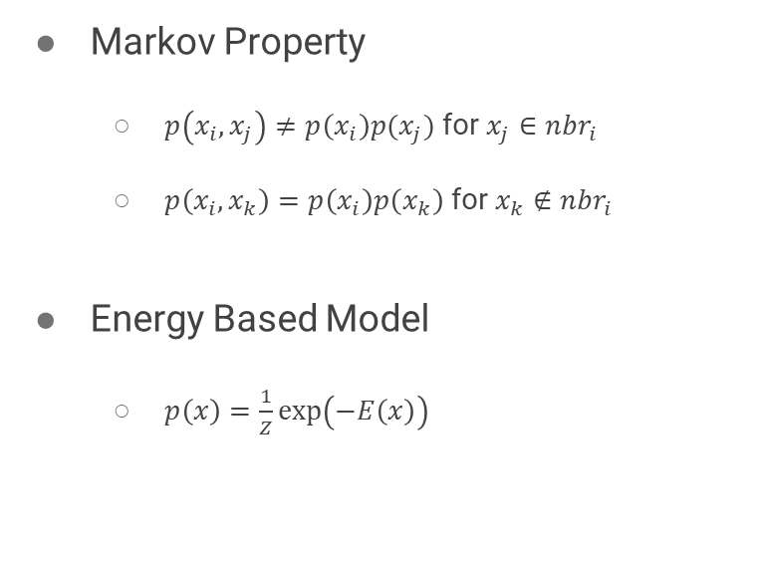
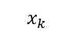
Part 1. Graphical Models (recap)
Markov Random Field
Markov Property
$p\left(x_{i}, x_{j}\right)≠p\left(x_{i}\right)p(x_{j})$ for $x_{j}∈nbr_{i}$
$p\left(x_{i},x_{k}\right)=p\left(x_{i}\right)p\left(x_{k}\right)$ for $x_{k}∉nbr_{i}$
Energy Based Model
$p\left(x\right)=\frac{1}{Z}\exp\left(−E\left(x\right)\right)$
$$x_{k}$$
$$x_{j}$$
$$nbr_{i}$$

Slide 8
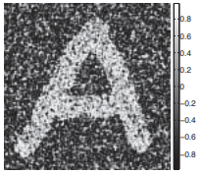
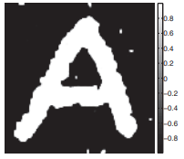
Part 1. Graphical Models (recap)
Image Denoising using Ising Model
Denoising
Noisy Image
Clean Image

Slide 9
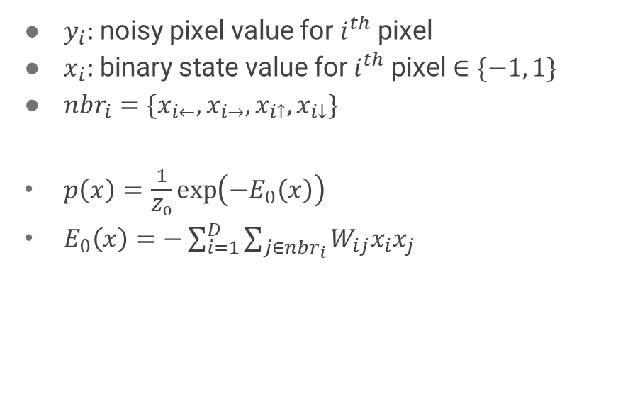
Part 1. Graphical Models (recap)
Ising Model
$y_{i}:$ noisy pixel value for $i^{th}$pixel
$x_{i}:$ binary state value for $i^{th}$pixel $∈\{−1, 1\}$
$nbr_{i}=\{x_{i←},x_{i→},x_{i↑},x_{i↓}\}$
$p\left(x\right)=\frac{1}{Z_{0}}\exp\left(−E_{0}\left(x\right)\right)$
$E_{0}\left(x\right)=−\sum_{i=1}^{D}{\sum_{j∈nbr_{i}}{W_{ij}x_{i}x_{j}}}$

Slide 10
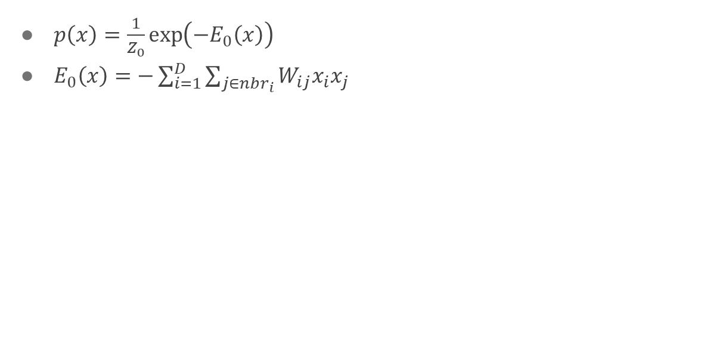
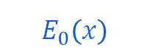
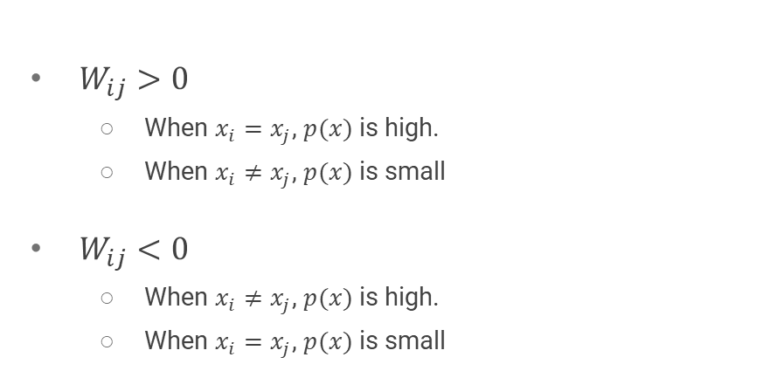
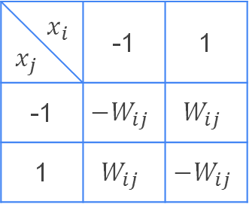
Part 1. Graphical Models (recap)
Ising Model
$p\left(x\right)=\frac{1}{Z_{0}}\exp\left(−E_{0}\left(x\right)\right)$
$E_{0}\left(x\right)=−\sum_{i=1}^{D}{\sum_{j∈nbr_{i}}{W_{ij}x_{i}x_{j}}}$
$W_{ij}>0$
When $x_{i}=x_{j}$, $p(x)$ is high.
When $x_{i}≠x_{j}$, $p(x)$ is small
$W_{ij}<0$
When $x_{i}≠x_{j}$, $p(x)$ is high.
When $x_{i}=x_{j}$, $p(x)$ is small
$$x_{i}$$ $$x_{j}$$ | -1 | 1
-1 | $${−W}_{ij}$$ | $$W_{ij}$$
1 | $$W_{ij}$$ | $${−W}_{ij}$$
$$E_{0}\left(x\right)$$

Slide 11
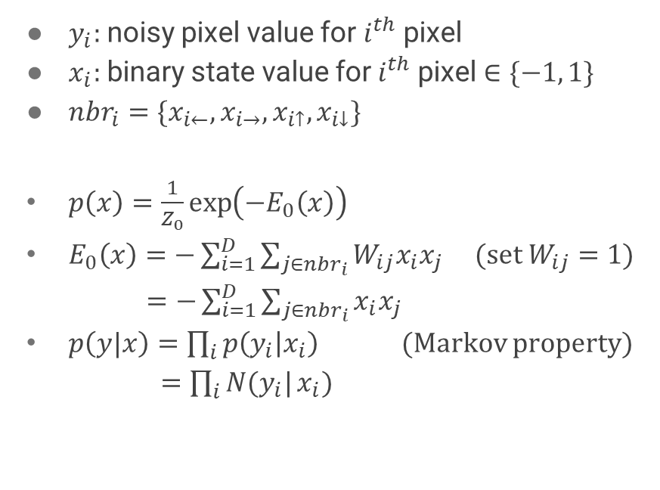
Part 1. Graphical Models (recap)
Ising Model
$y_{i}:$ noisy pixel value for $i^{th}$pixel
$x_{i}:$ binary state value for $i^{th}$pixel $∈\{−1, 1\}$
$nbr_{i}=\{x_{i←},x_{i→},x_{i↑},x_{i↓}\}$
$p\left(x\right)=\frac{1}{Z_{0}}\exp\left(−E_{0}\left(x\right)\right)$
$E_{0}\left(x\right)=−\sum_{i=1}^{D}{\sum_{j∈nbr_{i}}{W_{ij}x_{i}x_{j}}}$ (set $W_{ij}=1$)
$=−\sum_{i=1}^{D}{\sum_{j∈nbr_{i}}{x_{i}x_{j}}}$
$p\left(y|x\right)=\prod_{i}{p\left(y_{i} | x_{i}\right)}$ (Markov property)
$=\prod_{i}{N(y_{i}|}x_{i})$

Slide 12
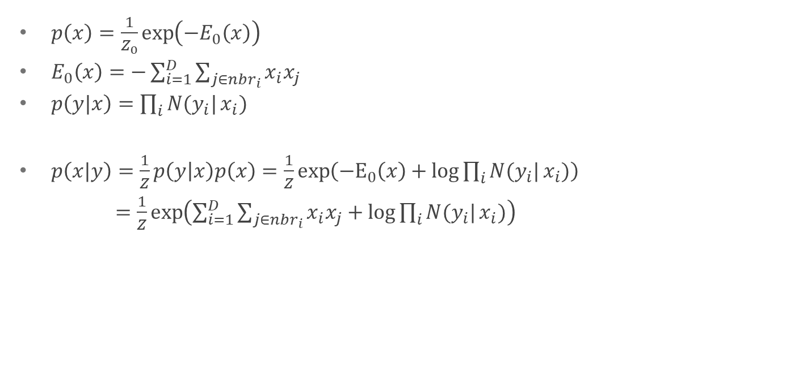
Part 1. Graphical Models (recap)
$p\left(x\right)=\frac{1}{Z_{0}}\exp\left(−E_{0}\left(x\right)\right)$
$E_{0}\left(x\right)=−\sum_{i=1}^{D}{\sum_{j∈nbr_{i}}{x_{i}x_{j}}}$
$p\left(y|x\right)=\prod_{i}{N(y_{i}|}x_{i})$
$p\left(x|y\right)=\frac{1}{Z}p\left(y | x\right)p\left(x\right)=\frac{1}{Z}\exp\left(−E_{0}\left(x\right)+\log{\prod_{i}{N(y_{i}|}x_{i})}\right)$
$=\frac{1}{Z}\exp\left(\sum_{i=1}^{D}{\sum_{j∈nbr_{i}}{x_{i}x_{j}}}+\log{\prod_{i}{N(y_{i}|}x_{i})}\right)$

Slide 13
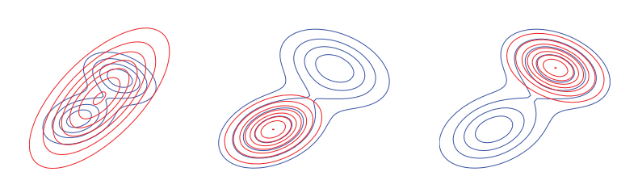
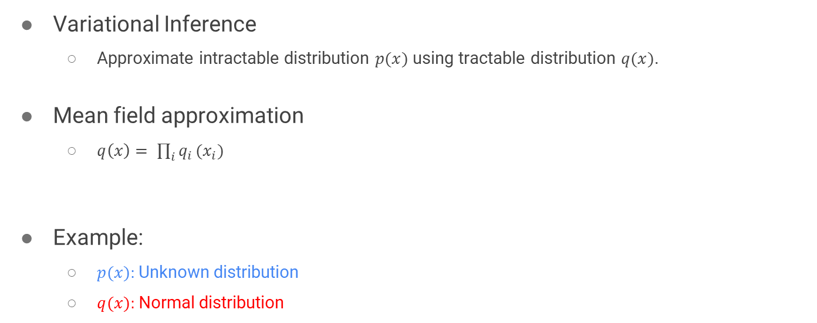
Part 1. Graphical Models (recap)
Variational Inference
Approximate intractable distribution $p(x)$ using tractable distribution $q(x)$.
Mean field approximation
$q\left(x\right)= \prod_{i}{q_{i}}(x_{i})$
Example:
$p(x):$Unknown distribution
$q(x):$Normal distribution
Target distribution
Proposal distribution

Slide 14
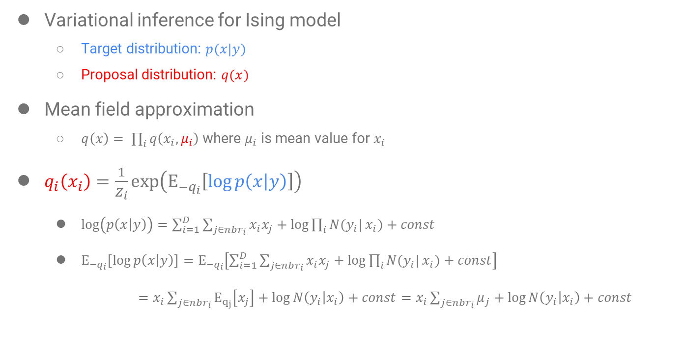
Part 1. Graphical Models (recap)
Variational inference for Ising model
Target distribution: $p(x|y)$
Proposal distribution: $q(x)$
Mean field approximation
$q\left(x\right)= \prod_{i}{q\left(x_{i},μ_{i}\right)}$ where $μ_{i}$ is mean value for $x_{i}$
$q_{i}\left(x_{i}\right)=\frac{1}{Z_{i}}\exp\left(Ε_{−q_{i}}\left[\log{p\left(x | y\right)}\right]\right)$
$\log\left(p\left(x | y\right)\right)=\sum_{i=1}^{D}{\sum_{j∈nbr_{i}}{x_{i}x_{j}}}+\log{\prod_{i}{N(y_{i}|}x_{i})}+const$
$Ε_{−q_{i}}\left[\log{p\left(x | y\right)}\right]=Ε_{−q_{i}}\left[\sum_{i=1}^{D}{\sum_{j∈nbr_{i}}{x_{i}x_{j}}}+\log{\prod_{i}{N(y_{i}|}x_{i})}+const\right]$
$=x_{i}\sum_{j∈nbr_{i}}{Ε_{q_{j}}\left[x_{j}\right]}+\log{N\left(y_{i} | x_{i}\right)}+const=x_{i}\sum_{j∈nbr_{i}}{μ_{j}}+\log{N\left(y_{i} | x_{i}\right)}+const$

Slide 15
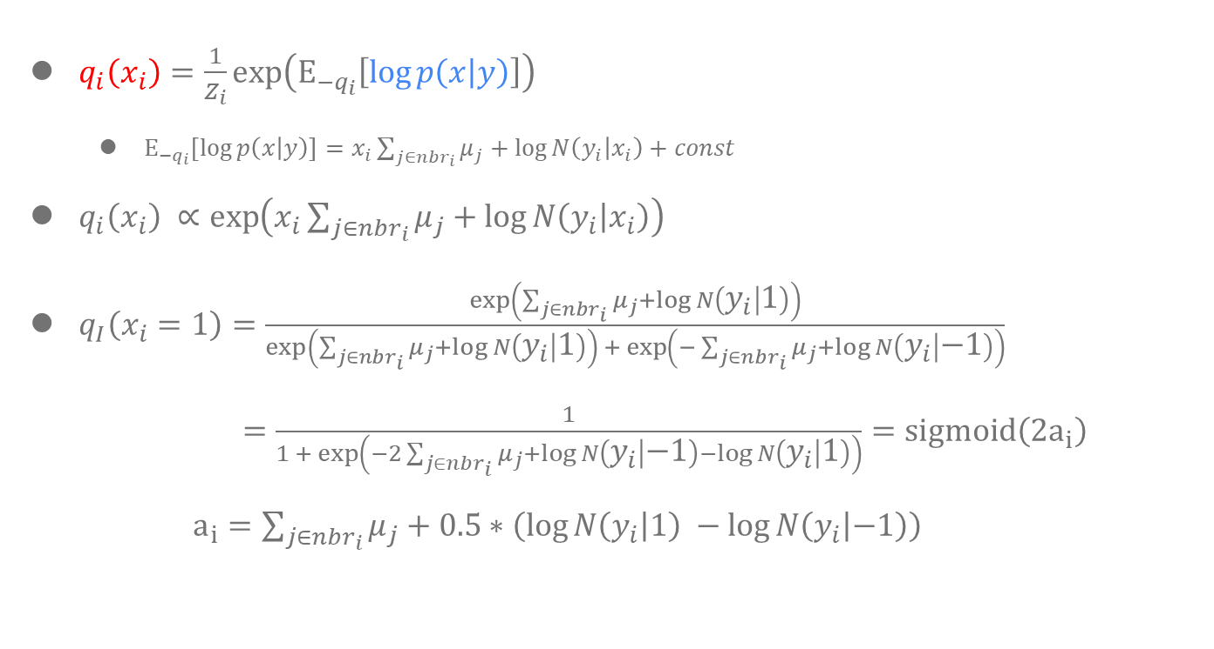
Part 1. Graphical Models (recap)
$q_{i}\left(x_{i}\right)=\frac{1}{Z_{i}}\exp\left(Ε_{−q_{i}}\left[\log{p\left(x | y\right)}\right]\right)$
$Ε_{−q_{i}}\left[\log{p\left(x | y\right)}\right]=x_{i}\sum_{j∈nbr_{i}}{μ_{j}}+\log{N\left(y_{i} | x_{i}\right)}+const$
$q_{i}\left(x_{i}\right) ∝\exp\left(x_{i}\sum_{j∈nbr_{i}}{μ_{j}}+\log{N\left(y_{i} | x_{i}\right)}\right)$
$q_{I}\left(x_{i}=1\right)=\frac{\exp\left(\sum_{j∈nbr_{i}}{μ_{j}}+\log{N\left(y_{i} | 1\right)}\right)}{\exp\left(\sum_{j∈nbr_{i}}{μ_{j}}+\log{N\left(y_{i} | 1\right)}\right) +\exp\left(−\sum_{j∈nbr_{i}}{μ_{j}}+\log{N\left(y_{i} | −1\right)}\right)}$
$=\frac{1}{1 + \exp\left(−2\sum_{j∈nbr_{i}}{μ_{j}}+\log{N\left(y_{i} | −1\right)}−\log{N\left(y_{i} | 1\right)}\right)}=sigmoid\left(2a_{i}\right)$
$a_{i}=\sum_{j∈nbr_{i}}{μ_{j}}+0.5∗\left(\log{N\left(y_{i} | 1\right)} −\log{N\left(y_{i} | −1\right)}\right)$

Slide 16
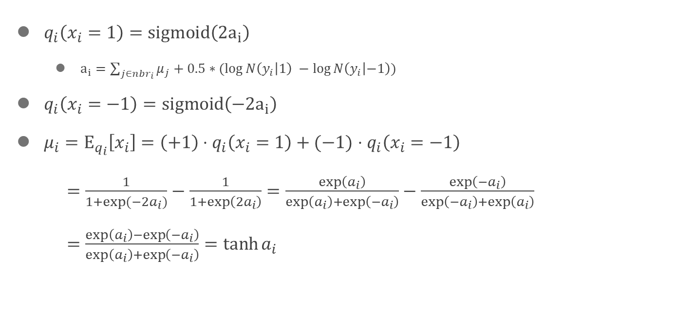
Part 1. Graphical Models (recap)
$q_{i}\left(x_{i}=1\right)=sigmoid\left(2a_{i}\right)$
$a_{i}=\sum_{j∈nbr_{i}}{μ_{j}}+0.5∗(\log{N\left(y_{i} | 1\right)} −\log{N\left(y_{i} | −1\right)})$
$q_{i}\left(x_{i}=−1\right)=sigmoid\left(−2a_{i}\right)$
$μ_{i}=Ε_{q_{i}}\left[x_{i}\right]=\left(+1\right)⋅q_{i}\left(x_{i}=1\right)+(−1)$ $⋅q_{i}\left(x_{i}=−1\right)$
$=\frac{1}{1+\exp{(−2a_{i})}}−\frac{1}{1+\exp\left(2a_{i}\right)}=\frac{\exp\left(a_{i}\right)}{\exp\left(a_{i}\right)+\exp\left(−a_{i}\right)}−\frac{\exp\left({−a}_{i}\right)}{\exp\left({−a}_{i}\right)+\exp\left(a_{i}\right)}$
$=\frac{\exp\left(a_{i}\right)−\exp\left({−a}_{i}\right)}{\exp\left(a_{i}\right)+\exp\left(−a_{i}\right)}=\tanh{a_{i}}$

Slide 17
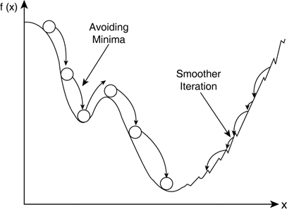
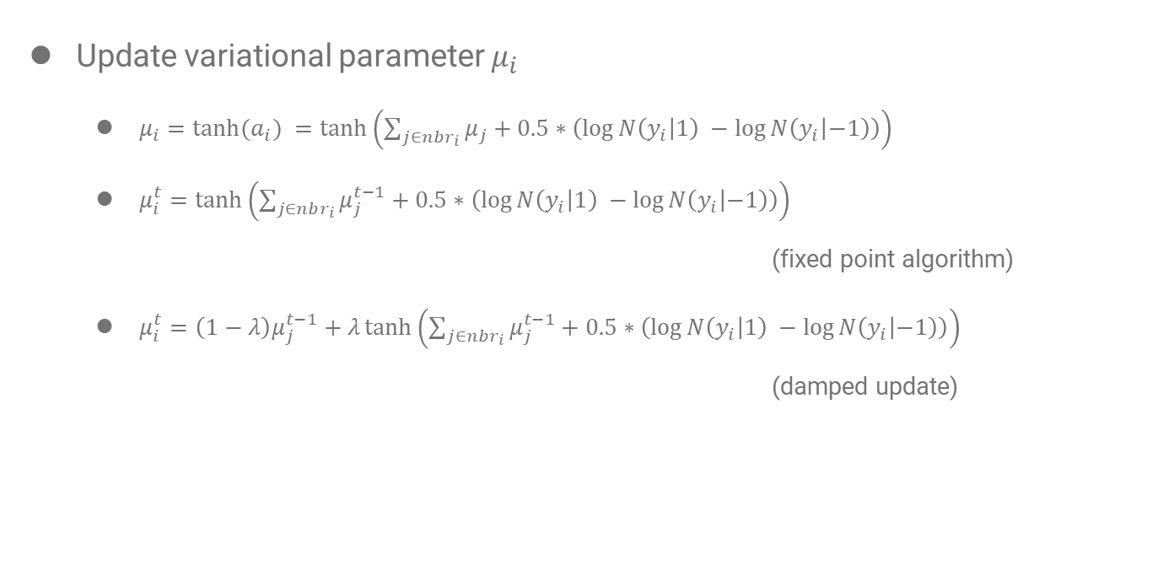
Part 1. Graphical Models (recap)
Update variational parameter $μ_{i}$
$μ_{i}=\tanh{{(a}_{i}) }=\tanh\left(\sum_{j∈nbr_{i}}{μ_{j}}+0.5∗\left(\log{N\left(y_{i} | 1\right)} −\log{N\left(y_{i} | −1\right)}\right)\right)$
$μ_{i}^{t}=\tanh\left(\sum_{j∈nbr_{i}}{μ_{j}^{t−1}}+0.5∗\left(\log{N\left(y_{i} | 1\right)} −\log{N\left(y_{i} | −1\right)}\right)\right)$
(fixed point algorithm)
$μ_{i}^{t}=\left(1−λ\right)μ_{j}^{t−1}+λ\tanh\left(\sum_{j∈nbr_{i}}{μ_{j}^{t−1}}+0.5∗\left(\log{N\left(y_{i} | 1\right)} −\log{N\left(y_{i} | −1\right)}\right)\right)$
(damped update)

Slide 18
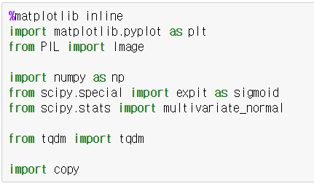
Part 1. Graphical Models (code)
To visualize data (e.g. plot)
Import library
To handle image data (e.g. open)
Mathematical library/function/class
To visualize progress
(e.g. iteration of loop)
For deep copy of array

Slide 19
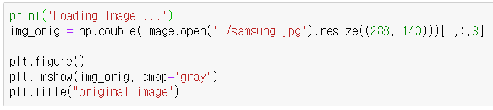
Part 1. Graphical Models (code)
Load image file as array
Load image from jpg file

Slide 20
Part 1. Graphical Models (code)
Load image file as array
Resize image for fast experiment
Load image from jpg file

Slide 21
Part 1. Graphical Models (code)
Load image file as array
Type cast from image to double array
Resize image for fast experiment
Load image from jpg file

Slide 22
Part 1. Graphical Models (code)
Load image file as array
Type cast from image to double array
Resize image for fast experiment
Load image from jpg file
Height x Width X RGBA

Slide 23
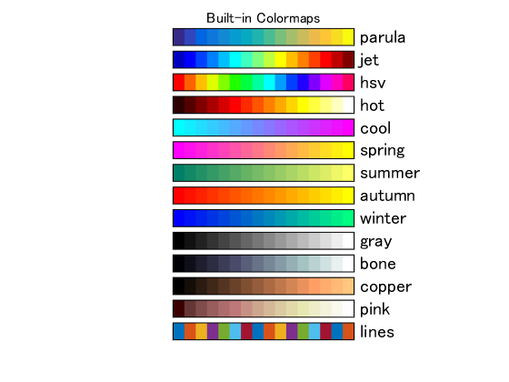
Part 1. Graphical Models (code)
Load image file as array
Type cast from image to double array
Resize image for fast experiment
Load image from jpg file
Height x Width X RGBA
Open new window
Plot image gray color map
Set title to plot

Slide 24
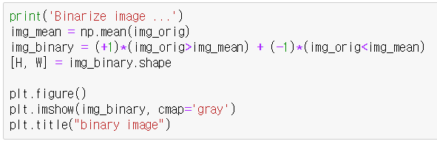
Part 1. Graphical Models (code)
Binarize pixel value of image
Compute mean pixel value of image
Binarize image based on mean pixel value
Get image size (Height and Width)

Slide 25
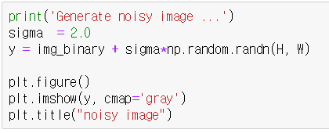
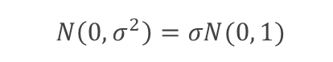
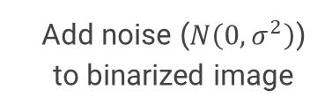
Part 1. Graphical Models (code)
Generate noisy image
Set the noise level (standard deviation=2.0)
Add noise ($N\left(0, σ^{2}\right)$) to binarized image
$$N\left(0, σ^{2}\right)=σN(0, 1)$$

Slide 26
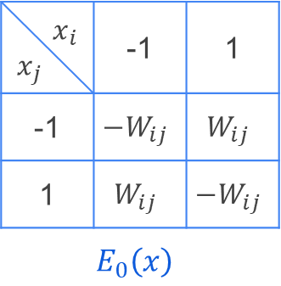
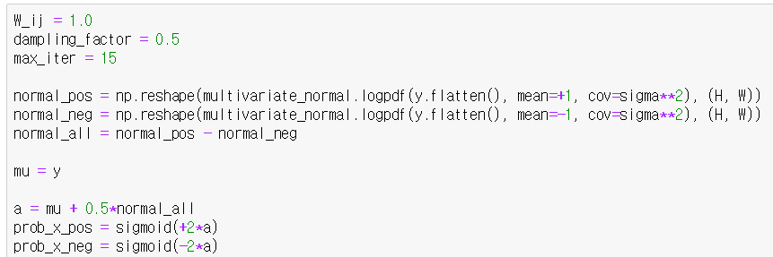
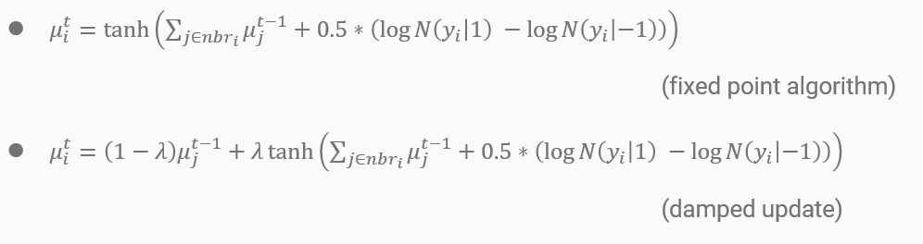
Part 1. Graphical Models (code)
Build Ising model

Slide 27
Part 1. Graphical Models (code)
Build Ising model

Slide 28
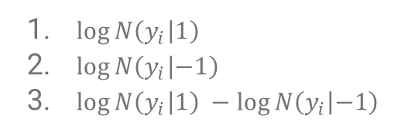
Part 1. Graphical Models (code)
Build Ising model
$\log{N\left(y_{i} | 1\right)}$
$\log{N\left(y_{i} | −1\right)}$
$\log{N\left(y_{i} | 1\right)} −\log{N\left(y_{i} | −1\right)}$

Slide 29
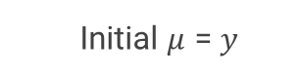
Part 1. Graphical Models (code)
Build Ising model
Initial $μ$ = $y$
$\log{N\left(y_{i} | 1\right)}$
$\log{N\left(y_{i} | −1\right)}$
$\log{N\left(y_{i} | 1\right)} −\log{N\left(y_{i} | −1\right)}$

Slide 30
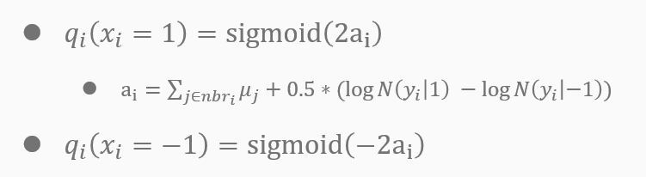

Part 1. Graphical Models (code)
Build Ising model
$\log{N\left(y_{i} | 1\right)}$
$\log{N\left(y_{i} | −1\right)}$
$\log{N\left(y_{i} | 1\right)} −\log{N\left(y_{i} | −1\right)}$
Initial $μ$ = $y$

Slide 31
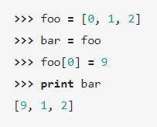
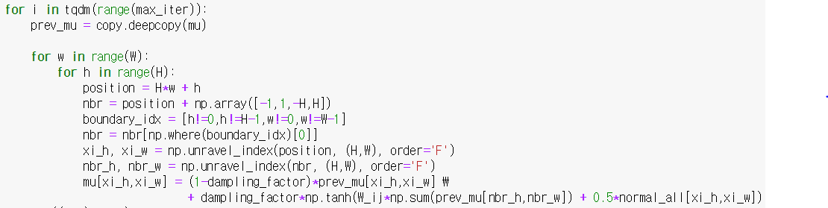
Part 1. Graphical Models (code)
Mean field variational inference
Visualize loop progress
(e.g. time per loop)
Deep copy for array

Slide 32

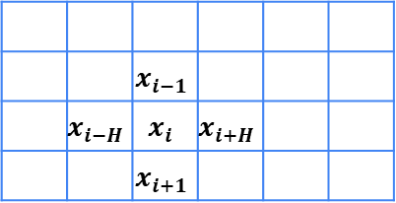
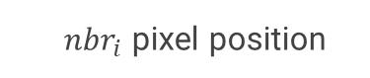
Part 1. Graphical Models (code)
Width (W)
Mean field variational inference
 |  | $$x_{i−1}$$
 | $$x_{i−H}$$ | $$x_{i}$$ | $$x_{i+H}$$
 |  | $$x_{i+1}$$
Height (H)
Loop for each pixel
Current pixel position ($x_{i}$)
$nbr_{i}$ pixel position

Slide 33
Part 1. Graphical Models (code)
Width (W)
Mean field variational inference
h=0 w=0
 |  |  |  |  | h=1 w=W-1
 |  | h=H-1 w=2
Height (H)
Loop for each pixel
Current pixel position ($x_{i}$)
Check whether current position is boundary

Slide 34
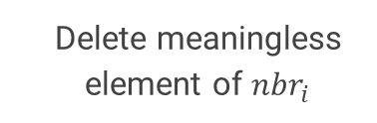
Part 1. Graphical Models (code)
Width (W)
Mean field variational inference
h=0 w=0
 |  |  |  |  | h=1 w=W-1
 |  | h=H-1 w=2
Height (H)
Loop for each pixel
Current pixel position ($x_{i}$)
Delete meaningless element of $nbr_{i}$

Slide 35
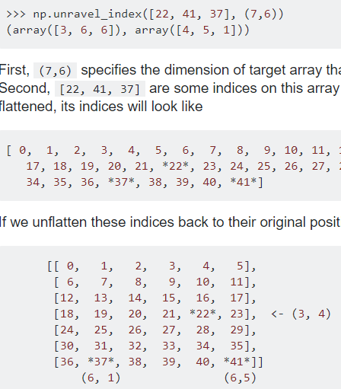
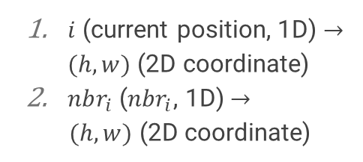
Part 1. Graphical Models (code)
Mean field variational inference
Loop for each pixel
$i$ (current position, 1D) $→(h,w)$ (2D coordinate)
$nbr_{i}$ ($nbr_{i}$, 1D) $→$
$(h,w)$ (2D coordinate)
Current pixel position ($x_{i}$)

Slide 36
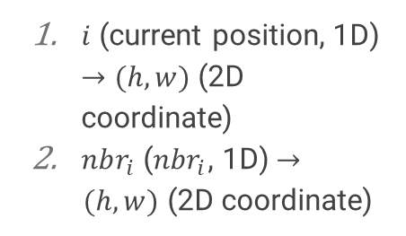
Part 1. Graphical Models (code)
Mean field variational inference
Loop for each pixel
$i$ (current position, 1D) $→(h,w)$ (2D coordinate)
$nbr_{i}$ ($nbr_{i}$, 1D) $→$
$(h,w)$ (2D coordinate)
Current pixel position ($x_{i}$)

Slide 37
Reference
[1] K. Murphy, “Machine Learning: A Probabilistic Perspective”, The MIT Press, 2012
[2] https://towardsdatascience.com/variational-inference-ising-model-6820d3d13f6a
[3] https://github.com/vsmolyakov/experiments_with_python/blob/master/chp02/mean_field_mrf.ipynb

Slide 38
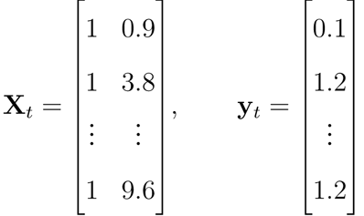
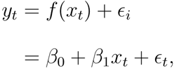
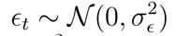
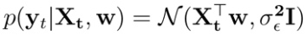
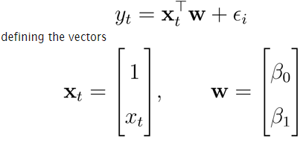
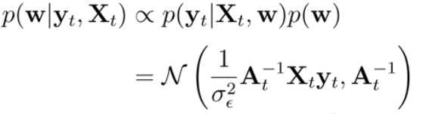
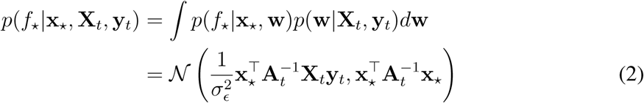
Part 2. Gaussian Process
Recall that in the simple linear regression setting.
To predict the output for x* , we need to estimate the weights from the previous observations.
In linear regression, we assume the outputs are a linear function of the inputs with additional noise:
If we use a Gaussian prior over the weights p(w) = 𝒩(0, Σ) and the Gaussian likelihood,
Notes:
새로운 데이터에 대한 아웃풋을 예측하기 위해서, 관찰한 데이터로부터 파라미터를 추정해야한다.
파라미터에 대해서 gaussian prior를 사용한다고 하고, gaussian likelihoood를 사용한다고 하면,

Slide 39
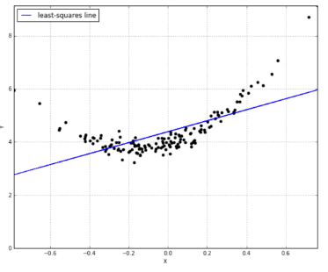
Part 2. Gaussian Process
But what if we don’t want to specify upfront how many parameters are involved?
We’d like to consider every possible function that matches our data, with however many parameters are involved.
That’s what non-parametric means: it’s not that there aren’t parameters, it’s that there are infinitely many parameters.
http://katbailey.github.io/post/gaussian-processes-for-dummies/

Slide 40

Part 2. Gaussian Process
1. Bayesian Inference + Gaussian Process
Bayesian inference를 통해 불확실성을 알 수 있다.
+ Gaussian Process는 함수 자체에 대한 Prior를 정의한다
= 함수 자체에 대한 불확실성을 볼 수 있다.
2. Gaussian distribution에서 뽑아 낸 랜덤 변수는 벡터이지만,
Gaussian process에서는 랜덤 함수 f(x)가 뽑혀져 나오며 이 함수는 제각각 각자의 평균과 분산을 갖습니다.
Notes:
우리에게 익숙한 Gaussian distribution은 mean vector와 variance matrix로부터 정의가 됩니다. 이를 일반화하여 생각하면 확장된 개념을 생각해볼 수 있습니다. Gaussian Process는 mean function m(x)m(x)과 covariance 함수 k(x,x′)k(x,x′) 로부터 정의됩니다. 따라서 ussian distribution은 벡터들에서 놀지만 Gaussian processs는 함수들에서 놀고 있습니다. 이러한 Gaussian process는 아래와 같이 표현됩니다. 따라서 Gaussian distribution에서 뽑아 낸 랜덤 변수는 벡터이지만, Gaussian process에서는 랜덤 함수 f(x)f(x)가 뽑혀져 나오며 이 함수는 제각각 각자의 평균과 분산을 갖습니다.

Slide 41

Part 2. Gaussian Process
3. Regression에서 Training data 간의 linear correlation이 높으면, training output 역시 높은 correlation을 갖는다. Kernel을 통해 이를 고려한 gaussian process를 만들 수 있다
4. Covariance function(kernel) 은 아래의 식과 같이 similarity 라고도
볼 수 있는 output 을 뽑아낸다. 즉, 두 점이 가까우면 covariance function
의 값이 높고, 두 점이 멀면 covariance function의 값이 낮다.
.
Notes:
우리에게 익숙한 Gaussian distribution은 mean vector와 variance matrix로부터 정의가 됩니다. 이를 일반화하여 생각하면 확장된 개념을 생각해볼 수 있습니다. Gaussian Process는 mean function m(x)m(x)과 covariance 함수 k(x,x′)k(x,x′) 로부터 정의됩니다. 따라서 ussian distribution은 벡터들에서 놀지만 Gaussian processs는 함수들에서 놀고 있습니다. 이러한 Gaussian process는 아래와 같이 표현됩니다. 따라서 Gaussian distribution에서 뽑아 낸 랜덤 변수는 벡터이지만, Gaussian process에서는 랜덤 함수 f(x)f(x)가 뽑혀져 나오며 이 함수는 제각각 각자의 평균과 분산을 갖습니다.

Slide 42

Part 2. Gaussian Process
1. Covariance function 의 종류, hyper-parameter 의 영향 overview
2. mean function 과 covariance function 을 정하여 GP로 정의된 Prior를 확인합니다.
3. 관찰된 데이터를 통해 Posterior를 확인합니다.
4. 관찰된 데이터에 최적화된 kernel의 hyper-parameter로 optimization 합니다.

Slide 43




Part 2. Gaussian Process
0. 다양한 커널에 대한 overview 및 intuition 획득
(1) Kernel 종류에 따른 covariance function의 변화를 확인. (2) Kernel에서의 length scale에 따른 covariance function의 변화를 확인

Slide 44








Part 2. Gaussian Process
0. 다양한 커널에 대한 overview 및 intuition 획득
(3) Sample paths from a GP.
1. RBF kernel
2. Exponential kernel
3. Linear kernel
4. Exponential Quadratic kernel

Slide 45



Part 2. Gaussian Process
1. 1D regression에 대하여 여러커널에 적합한 데이터셋을 생성 및 학습.
(1) GP regression model ( RBF kernel )
1. RBF kernel
2. Exponential kernel
3. Linear kernel
4. Exponential Quadratic kernel

Slide 46


Part 2. Gaussian Process
1. 1D regression에 대하여 여러커널에 적합한 데이터셋을 생성 및 학습.
(2) GP regression model ( Exponential kernel )
1. RBF kernel
2. Exponential kernel
3. Linear kernel
4. Exponential Quadratic kernel

Slide 47


Part 2. Gaussian Process
1. 1D regression에 대하여 여러커널에 적합한 데이터셋을 생성 및 학습.
(3) GP regression model ( Linear kernel )
1. RBF kernel
2. Exponential kernel
3. Linear kernel
4. Exponential Quadratic kernel

Slide 48

Part 2. Gaussian Process
1. 1D regression에 대하여 여러커널에 적합한 데이터셋을 생성 및 학습.
(4) GP regression model ( Exponential Quadratic kernel )
1. RBF kernel
2. Exponential kernel
3. Linear kernel
4. Exponential Quadratic kernel

Slide 49
Part 3. Hawkes Process
Overview
Point Process
Poisson Process
Hawkes Process
Predicting Retweet Dynamics
* This part refers to the ICML 2018 tutorial Learning with Temporal Point Processes (Rodriguez and Valera, 2018)
* Also, predicting Retweet dynamics refers to TideH (Kobayashi and Lambiotte, 2016).

Slide 50





Part 3. Hawkes Process
Many discrete events in continuous time !
Earthquake
Online actions
Disease dynamics
Financial trading
Mobility dynamics

Slide 51







Part 3. Hawkes Process
Variety of processes behind these events
Stock trading
Flu spreading
Article creation in Wikipedia
News spread in Twitter
Reviews and sales in Amazon
A user’s reputation in Quora
Ride-sharing requests
Fast
Slow
…in a wide range of temporal scales.

Slide 52






Part 3. Hawkes Process
Real World Examples
S
D
Christine
means
3.00pm
D follows S
Bob
3.25pm
Beth
3.27pm
Joe
David
Friggeri et al., 2014
4.15pm

Slide 53


Part 3. Hawkes Process
Temporal point process is a random process whose realization consists of discrete events localized in time
Discrete events
$$N\left(t\right)∈\left\{0\right\}∪ℤ^{+}$$
time
History, $ℋ(t)$
$$dN\left(t\right)∈\left\{0,1\right\}$$
Dirac delta function
Formally: $N\left(t\right)=\int_{0}^{t}{dN(s)}$
$$dN\left(t\right)=\sum_{t_{i}∈ℋ(t)}{δ\left(t−t_{i}\right)dt }$$

Slide 54
Part 3. Hawkes Process
Temporal Point process can be represented as Intensity function
$$N(t)$$
time
t₁
t₂
t₃
History $ℋ(t)$
Since it is cumbersome to model event counts over time, we model event intensity over time.
$$λ^{∗}\left(t\right)dt=𝔼\left[dN\left(t\right) | ℋ\left(t\right)\right]$$
It is a rate = # of events / unit of time
Notes:
λ∗(t) is expected value of (infinitesimal) change in event count over time, given event history
⇔ λ∗(t) is number of events per time interval, and this changes over time!

Slide 55
Part 3. Hawkes Process
Poisson process
$$N(t)$$
time
t₁
t₂
t₃
t
Intensity of a Poisson process
$$λ^{∗}\left(t\right)=μ$$
Observations:
Intensity independent of history
Uniformly random occurrence
Time interval follows exponential distribution

Slide 56
Part 3. Hawkes Process
Hawkes process: Self-exciting intensity function
time
t₁
t₂
t₃
History 𝓗(t)
Self-exciting: each arrival increase the rate of future arrivals for some period
Intensity of Hawkes process:
$$λ^{∗}\left(t\right)=μ+α\sum_{t_{i}<t}{φ(t−t_{i})}$$
Baseline
Triggering kernel
Observations:
Clustered (or bursty) occurrence of events
Intensity is stochastic and history dependent

Slide 57
Part 3. Hawkes Process
Tick: Python Library for statistical learning about point processes
How to Install
cogito@digits-1:~$ pip install tick
cogito@digits-1:~$ pip install –-upgrade scipy==1.0.0 # optional
cogito@digits-1:~$ pip install dill # optional
Notes:
- Tick 깔았는데 아래 에러 나면, pip install –upgrade scipy
ImportError: cannot import name 'comb‘
Kernels for Hawkes process simulation
A Hawkes process is defined through its kernels which are functions defined on [0,∞).

Slide 58

Part 3. Hawkes Process
Tick: Python Library for statistical learning about point processes
How to Use - Simulation
from tick.hawkes import HawkesKernel0, HawkesKernelExp, HawkesKernelPowerLaw, HawkesKernelTimeFunc
...
kernel_exp = HawkesKernelExp(.7, 1.3) # HawkesKernelExp(intensity, decay)
t_values = np.linspace(0, 3, 100)
kernel_exp.get_values(t_values)) # Simulation using get_values([times])
Let’s run the sample code !
Notes:
- Tick 깔았는데 아래 에러 나면, pip install –upgrade scipy
ImportError: cannot import name 'comb‘
Kernels for Hawkes process simulation
A Hawkes process is defined through its kernels which are functions defined on [0,∞).

Slide 59



Part 3. Predicting Retweet Dynamics using Hawkes Process
Predicting Retweet Dynamics using Hawkes Process
time
t₁
t₂
t₃
t₄
t₆
Kobayashi, R., & Lambiotte, R. (2016, March). Tideh: Time-dependent hawkes process for predicting retweet dynamics. In Tenth International AAAI Conference on Web and Social Media.

Slide 60
Part 3. Predicting Retweet Dynamics using Hawkes Process
Get ready for the codes!
https://github.com/NII-Kobayashi/TiDeH
cogito@digits-1:~$ git clone https://github.com/NII-Kobayashi/TiDeH
Cloning into 'TiDeH'...
remote: Enumerating objects: 132, done.
remote: Total 132 (delta 0), reused 0 (delta 0), pack-reused 132
Receiving objects: 100% (132/132), 1.61 MiB | 310.00 KiB/s, done.
Resolving deltas: 100% (9/9), done.
Checking connectivity... done.
cogito@digits-1:~$ cd TiDeH/
파일 소스 트리
Kobayashi, R., & Lambiotte, R. (2016, March). Tideh: Time-dependent hawkes process for predicting retweet dynamics. In Tenth International AAAI Conference on Web and Social Media.

Slide 61
Part 3. Predicting Retweet Dynamics using Hawkes Process
What you will see is …
TiDeH/
| data/
| | example/
| | | sample_file.txt*
| | training/
| tideh/
| | __init__.py*
| | estimate.py*
| | fit.py*
| | functions.py*
| | main.py*
| | prediction.py*
| | simulate.py*
| | training.py*
| example_native.py*
| example_optimized.py*
| example_simulation.py*
| example_training.py*
2150 160.627488
0.000000 503173
0.000021 133
0.000324 40
0.000910 73
0.003047 83
0.003141 30
0.003451 15
0.003552 305
0.003970 208
0.006932 82
0.006984 287
0.007528 124
0.007718 100
0.008874 17
0.008999 77
0.009056 101
0.009210 28
* one file per tweet
* space separated
* only tweets with more than 2000 retweets were used
First row
<number of total retweets>
<start time of tweet in days>

Slide 62

Part 3. Predicting Retweet Dynamics using Hawkes Process
What you will see is …
TiDeH/
| data/
| | example/
| | | sample_file.txt*
| | training/
| tideh/
| | __init__.py*
| | estimate.py*
| | fit.py*
| | functions.py*
| | main.py*
| | prediction.py*
| | simulate.py*
| | training.py*
| example_native.py*
| example_optimized.py*
| example_simulation.py*
| example_training.py*
2150 160.627488
0.000000 503173
0.000021 133
0.000324 40
0.000910 73
0.003047 83
0.003141 30
0.003451 15
0.003552 305
0.003970 208
0.006932 82
0.006984 287
0.007528 124
0.007718 100
0.008874 17
0.008999 77
0.009056 101
0.009210 28
* one file per tweet
* space separated
* only tweets with more than 2000 retweets were used
First row
<number of total retweets>
<start time of tweet in days>
Every other row
<relative tweeted/retweeted time in seconds> <number of followers of retweeting person>
time
Actual time
0.500
Original Tweet
t = 0
Follower: 90
Retweet
t = 292
Follower: 43344

Slide 63
Part 3. Predicting Retweet Dynamics using Hawkes Process
How to run the example code
cogito@digits-1:~/TiDeH$ python3 example_native.py
Example of predicting future retweet activity. Given an observation time, the parameters of the infectious rate are estimated and then, the number of retweets before a given time is predicted.
Then, you will see the results
Estimated parameters are:
p0: 0.001
r0: 0.414
phi0: 0.140
tm: 1.822
Average % error (estimated to fitted): 12.33
Predicted number of retweets from 48 to 168 hours: 37
Predicted number of retweets at hour 168: 2170
Prediction error (absolute): 20

Slide 64
Part 3. Predicting Retweet Dynamics using Hawkes Process
How to run the example code
Let’s look at the code example_native.py
# Module import
from tideh import estimate_parameters
from tideh import load_events
from tideh import predict
# Read dataset
filename = 'data/example/sample_file.txt'
(_, start_time), events = load_events(filename)
Notes:
$p\left(t\right)$: infectious rate
$t_{i}$: the time of i-th retweet
$d_{i}$: followers of the i-th retweeting person
$φ\left(⋅\right)$: exciting kernel, a probability distribution for the time interval between a tweet by the followee and its retweet by the follower.

Slide 65
Part 3. Predicting Retweet Dynamics using Hawkes Process
How to run the example code
Let’s look at the code example_native.py
# additional parameters passed to infectious rate function
add_params = {'t0': start_time, 'bounds': [(-1, 0.5), (1, 20.)]}
obs_time = 48 # observation time of 2 days
pred_time = 168 # predict for one week
params, err, _ = estimate_parameters(events=events, obs_time=obs_time, **add_params)
The probability for getting a retweet in a small-time interval $\left[t,t+∆t\right]$ is $λ\left(t\right)∆t.$
$$λ\left(t\right)=p(t)\sum_{i:t_{i}<t}{d_{i}φ(t−t_{i})}$$
Exciting kernel
Infectious
rate
# Followers
Notes:
$p\left(t\right)$: infectious rate
$t_{i}$: the time of i-th retweet
$d_{i}$: followers of the i-th retweeting person
$φ\left(⋅\right)$: exciting kernel, a probability distribution for the time interval between a tweet by the followee and its retweet by the follower.

Slide 66

Part 3. Predicting Retweet Dynamics using Hawkes Process
How to run the example code
Let’s look at the code example_native.py
# additional parameters passed to infectious rate function, bounds for r0 and taum
add_params = {'t0': start_time, 'bounds': [(-1, 0.5), (1, 20.)]}
obs_time = 48 # observation time of 2 days
pred_time = 168 # predict for one week
params, err, _ = estimate_parameters(events=events, obs_time=obs_time, **add_params)
Infectious rate is
$$p\left(t\right)=p_{0}\left\{1−r_{0}\sin\left(\frac{2π}{T_{m}}\left(t+φ_{0}\right)\right) \right\}e^{−(t−t_{0})/τ_{m}}$$
$t_{0}$: time of the original tweet
$T_{m}=1 day$: period of oscillation
$p_{0}$: intensity
$r_{0}$ : the relative amplitude of the oscillation
$φ_{0}$: its phase
$τ_{m}:$ characteristic time of popularity decay
Notes:
$p\left(t\right)$: infectious rate
$t_{i}$: the time of i-th retweet
$d_{i}$: followers of the i-th retweeting person
$φ\left(⋅\right)$: exciting kernel, a probability distribution for the time interval between a tweet by the followee and its retweet by the follower.

Slide 67
Part 3. Predicting Retweet Dynamics using Hawkes Process
How to run the example code
Let’s look at the code example_native.py
# additional parameters passed to infectious rate function, bounds for r0 and taum
add_params = {'t0': start_time, 'bounds': [(-1, 0.5), (1, 20.)]}
obs_time = 48 # observation time of 2 days
pred_time = 168 # predict for one week
params, err, _ = estimate_parameters(events=events, obs_time=obs_time, **add_params)
Infectious rate is
$$p\left(t\right)=p_{0}\left\{1−r_{0}\sin\left(\frac{2π}{T_{m}}\left(t+φ_{0}\right)\right) \right\}e^{−(t−t_{0})/τ_{m}}$$
$t_{0}$: time of the original tweet
$T_{m}=1 day$: period of oscillation
$p_{0}$: intensity
$r_{0}$ : the relative amplitude of the oscillation
$φ_{0}$: its phase
$τ_{m}:$ characteristic time of popularity decay
Notes:
$p\left(t\right)$: infectious rate
$t_{i}$: the time of i-th retweet
$d_{i}$: followers of the i-th retweeting person
$φ\left(⋅\right)$: exciting kernel, a probability distribution for the time interval between a tweet by the followee and its retweet by the follower.

Slide 68
Part 3. Predicting Retweet Dynamics using Hawkes Process
How to run the example code
Let’s look at the code example_native.py
# tideh/main.py - Estimate of model parameters of TiDeH (p_0, r_0, phi_0, t_m).
def estimate_parameters(events, obs_time=None, window_size=4, window_stride=1,
kernel_int=functions.integral_zhao,
p=functions.infectious_rate_tweets, values=None, **p_params):
obs_time = int(min(obs_time, events[len(events) - 1][0]))
events = [e for e in events if e[0] < obs_time] # e[0] holds time of the event
estimations, window_event_count, window_middle = \
estimate.estimate_infectious_rate(events, kernel_int, obs_time, window_size, window_stride)
fitted = fit.fit_parameter(estimates=estimations, fun=lambda x, *args: p(x, *args, **p_params),
start_values=values, xval=window_middle)
# tideh/estimate.py – Esitmate base rate p0
def estimate_infectious_rate(events, kernel_integral=functions.integral_zhao, obs_time=24, window_size=4,
window_stride=1):
for start in range(0, obs_time - window_size + window_stride, window_stride):
...
est = estimate_infectious_rate_constant(events=events_tmp, t_start=start, t_end=end,
kernel_integral=kernel_integral, count_events=count_current)
...
Notes:
$p\left(t\right)$: infectious rate
$t_{i}$: the time of i-th retweet
$d_{i}$: followers of the i-th retweeting person
$φ\left(⋅\right)$: exciting kernel, a probability distribution for the time interval between a tweet by the followee and its retweet by the follower.

Slide 69
Part 3. Predicting Retweet Dynamics using Hawkes Process
How to run the example code
Let’s look at the code example_native.py
# tideh/main.py
def estimate_parameters(events, obs_time=None, window_size=4, window_stride=1,
kernel_int=functions.integral_zhao,
p=functions.infectious_rate_tweets, values=None, **p_params):
obs_time = int(min(obs_time, events[len(events) - 1][0]))
events = [e for e in events if e[0] < obs_time] # e[0] holds time of the event
estimations, window_event_count, window_middle = \
estimate.estimate_infectious_rate(events, kernel_int, obs_time, window_size, window_stride)
fitted = fit.fit_parameter(estimates=estimations, fun=lambda x, *args: p(x, *args, **p_params),
start_values=values, xval=window_middle)
# tideh/fit.py - Estimate of model parameters r_0, phi_0, t_m
from scipy.optimize import leastsq
def fit_parameter(estimates, fun, start_values, xval):
if start_values is None:
start_values = np.array([0, 0, 0, 1.])
return leastsq(func=loss_function, x0=start_values, args=(estimates, fun, xval))[0]
Notes:
$p\left(t\right)$: infectious rate
$t_{i}$: the time of i-th retweet
$d_{i}$: followers of the i-th retweeting person
$φ\left(⋅\right)$: exciting kernel, a probability distribution for the time interval between a tweet by the followee and its retweet by the follower.

Slide 70

Part 3. Predicting Retweet Dynamics using Hawkes Process
How to run the example code
Then, where is the exciting kernel?
# additional parameters passed to infectious rate function
add_params = {'t0': start_time, 'bounds': [(-1, 0.5), (1, 20.)]}
obs_time = 48 # observation time of 2 days
pred_time = 168 # predict for one week
params, err, _ = estimate_parameters(events=events, obs_time=obs_time, **add_params)
The probability for getting a retweet in a small-time interval $\left[t,t+∆t\right]$ is $λ\left(t\right)∆t.$
Exciting kernel is fitted to the empirical data by the function where is the heavily tailed in a variety of social networks (Crane, et al. 2008, Masuda, et al. 2013)
$$λ\left(t\right)=p(t)\sum_{i:t_{i}<t}{d_{i}φ(t−t_{i})}$$
Exciting kernel
$c_{0}=6.49×{10}^{−4} seconds$
$s_{0}=300 seconds$
$θ=0.242$
Notes:
$p\left(t\right)$: infectious rate
$t_{i}$: the time of i-th retweet
$d_{i}$: followers of the i-th retweeting person
$φ\left(⋅\right)$: exciting kernel, a probability distribution for the time interval between a tweet by the followee and its retweet by the follower.

Slide 71
Part 3. Predicting Retweet Dynamics using Hawkes Process
We are going to estimate the exciting kernel from the dataset.
Then, where is the exciting kernel?
$c_{0}=6.49×{10}^{−4} seconds$
$s_{0}=300 seconds$
$θ=0.242$
Now, let’s estimate the kernel !
Notes:
$p\left(t\right)$: infectious rate
$t_{i}$: the time of i-th retweet
$d_{i}$: followers of the i-th retweeting person
$φ\left(⋅\right)$: exciting kernel, a probability distribution for the time interval between a tweet by the followee and its retweet by the follower.

